Slide 1
RoboCallBlocker
Shawn Choudhury
Joshua Chopra
Thomas Tee
[12/8/2019]

Slide 2
Background
According to the Federal Trade Commission, a government agency which deals with consumer protection, its Do Not Call Registry expanded to approx. 240 million participants in 2019.
In previous years, robocalls were sourced from telemarketing.
However, in 2019 there has been an uptick in the more insidious imposter calls such as automated calls received regarding prescription medications, debt-relief programs and even the IRS
This project gave us the opportunity to experiment with a problem that many of us experience.

Slide 3
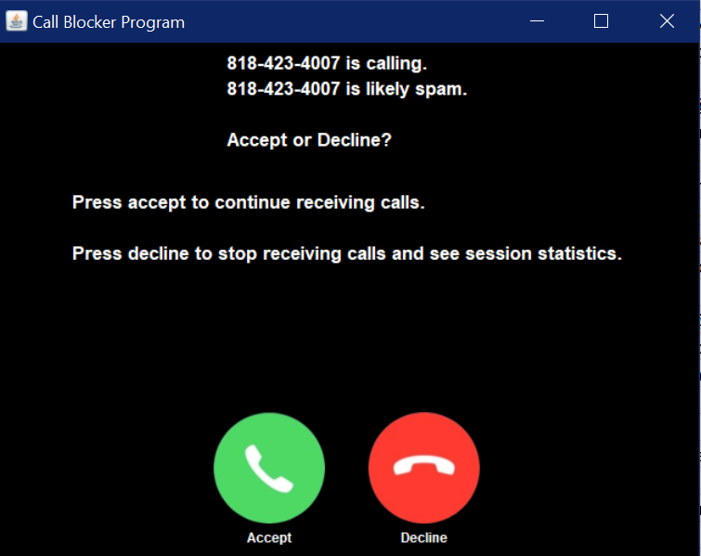
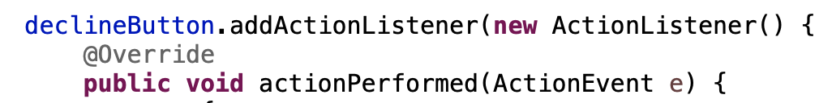
GUI
Our project revolves around our GUI
The GUI replicates an incoming call
It gets tagged as spam in the GUI to inform the user before they decide to accept or decline the call
The incoming calls get tagged as spam by an algorithm we’ve devised in our SpamAlgorithm class

Slide 4
SpamAlgorithm
The SpamAlgorithm class is the engine for our program
The methods in this class check if an incoming caller’s information matches with any of the contacts in their phone
We assume that our phone is sophisticated enough to access various user details, such as social media accounts
Some of the attributes it scores includes names, phone numbers, addresses, zip codes, email addresses, social media accounts, etc.

Slide 5
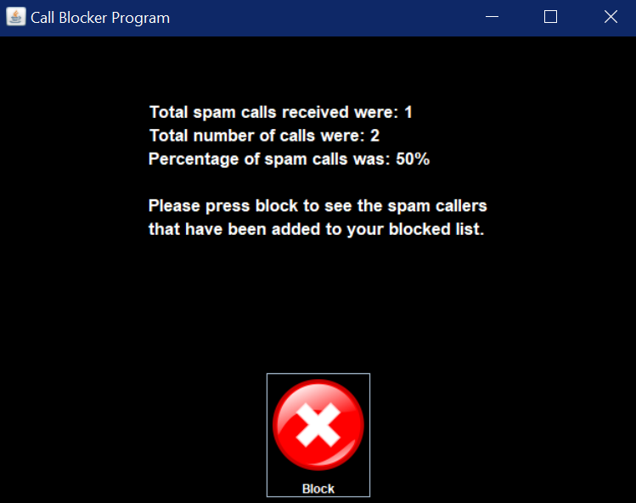
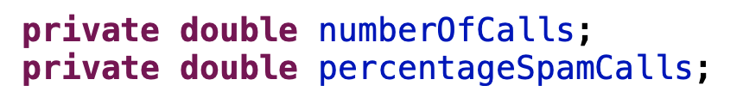
Results
After using the program, the GUI will display the results of all the calls that were received
Stats on the percentage of spam calls received are displayed

Slide 6
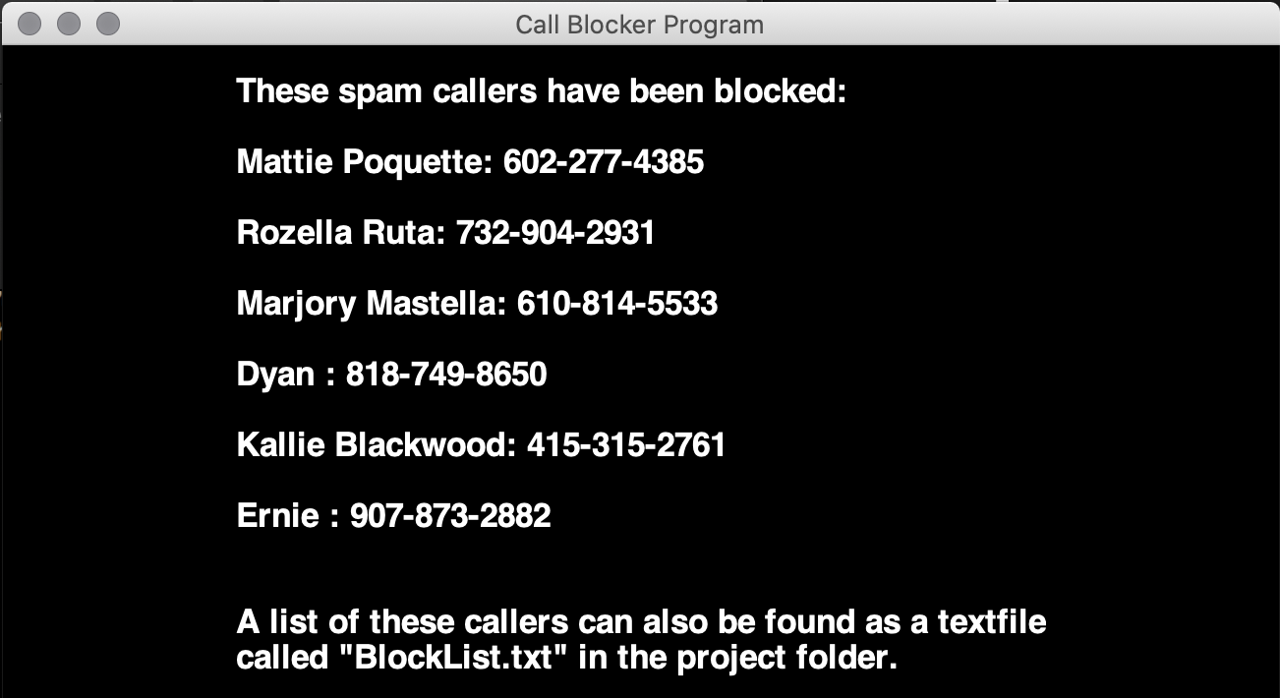
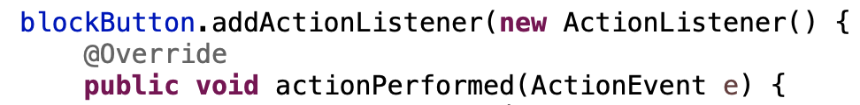
BlockList
The BlockList is a HashMap data structure that is populated spam callers determined in our SpamAlgorithm class
At the end of the program, a block button is displayed on the bottom
If clicked, it will display a list of the spam callers that were added to the BlockList
Additionally, a text file called BlockList.txt containing the spam callers will available in the project folder

Slide 7
Bibliography
https://www.ftc.gov/news-events/press-releases/2019/10/ftc-releases-fy-2019-national-do-not-call-registry-data-book

